Slide 1

Impact of covid on overseas migration to Australia
Bec, Anuja and Luz

Slide 2

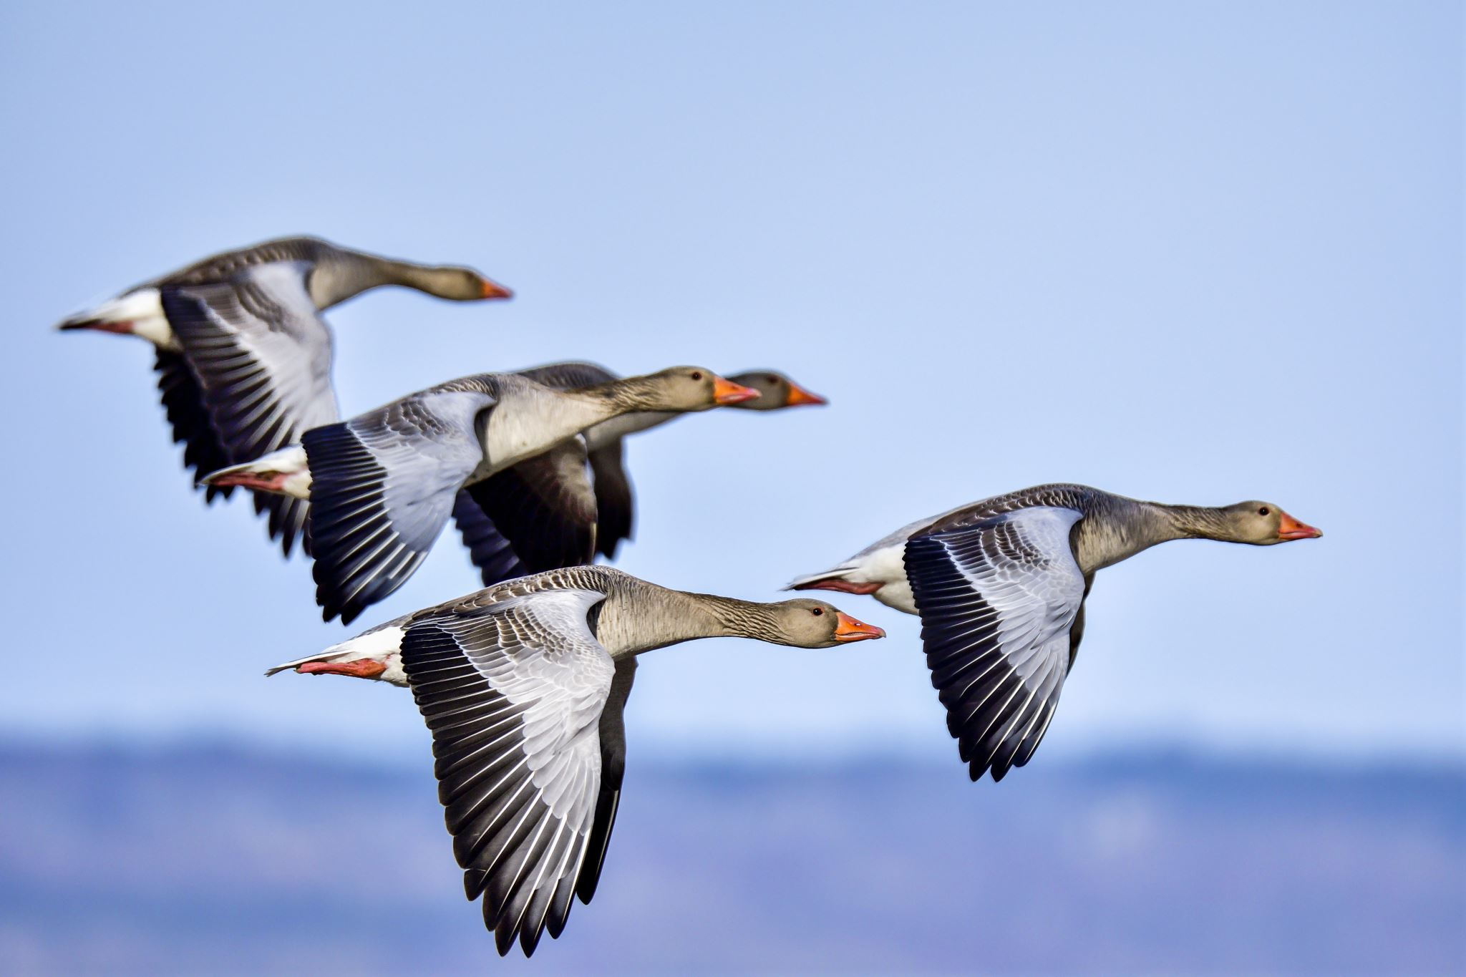
Agenda
Introduction​
Research Question
Analysis

Slide 3
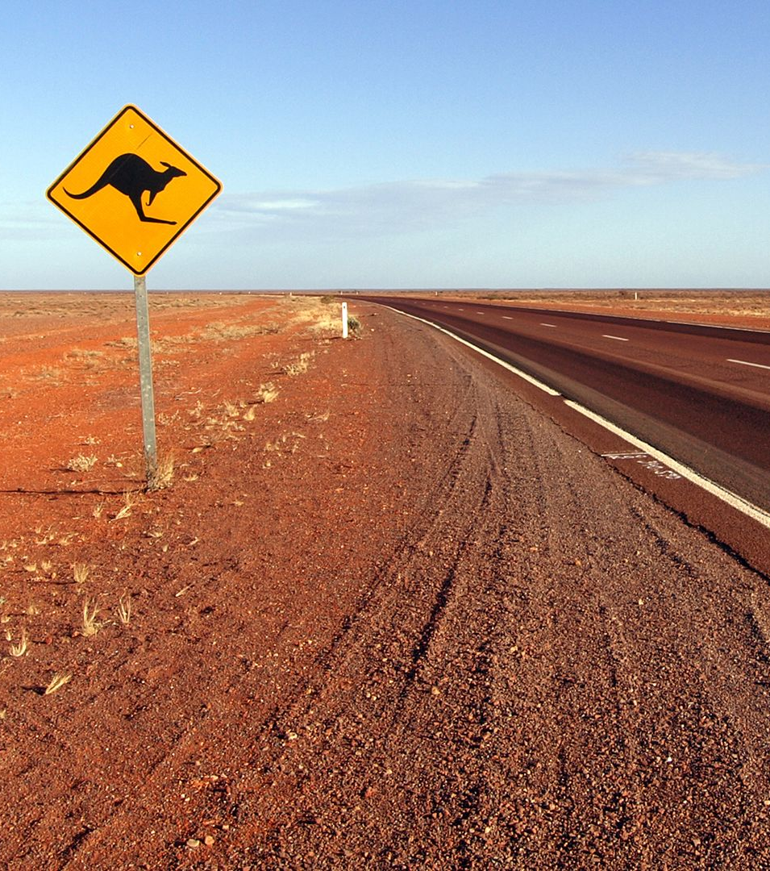

Introduction
“Australia's migrant population is expected to have grown by more than 700,000 between the 2022 and 2024 financial years.”
- ABC News

Slide 4

Research question
How has COVID affected migration
arrivals to Australia pre and post
2020, and specifically:
State / Location;
Gender;
Age;
Purpose (visa status);and
Work Hours.

Slide 5

Analysis

Slide 6
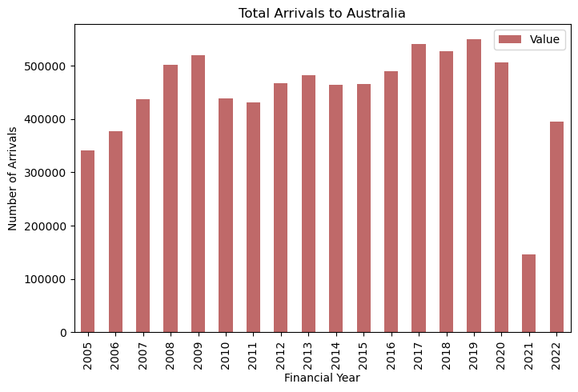
Summary of Migrant arrivals

Slide 7
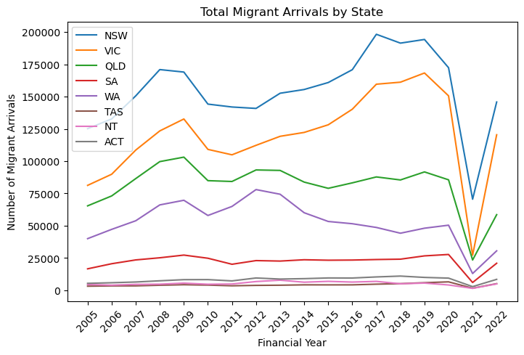
Location

Slide 8
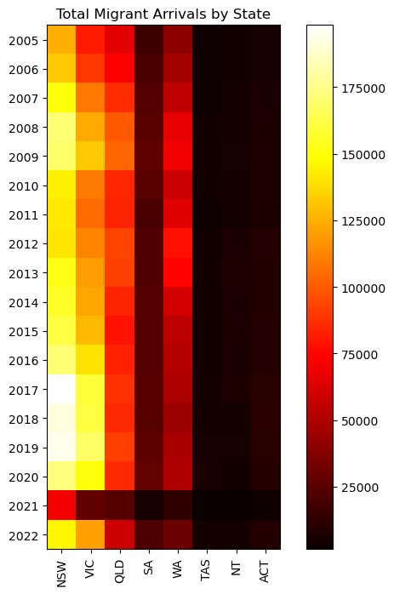
Location

Slide 9
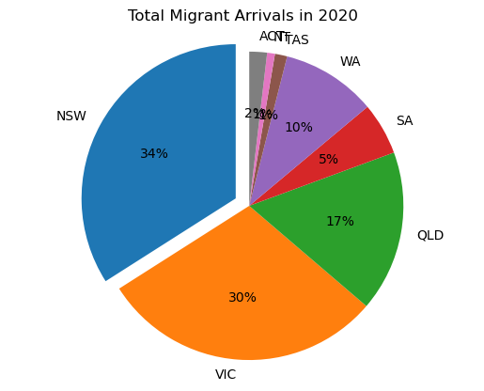
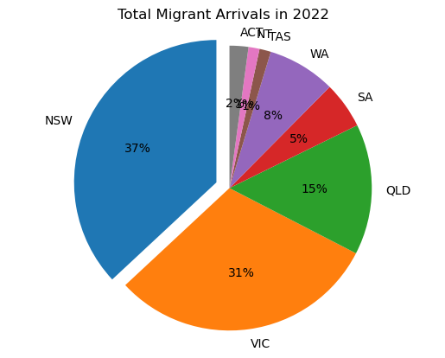
Location

Slide 10
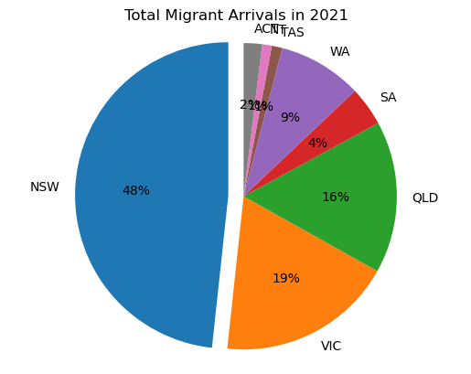
Location

Slide 11
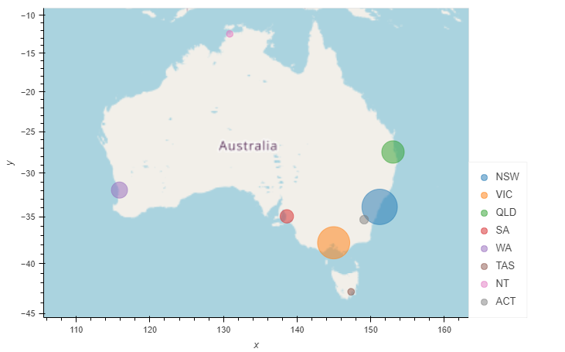
Location

Slide 12
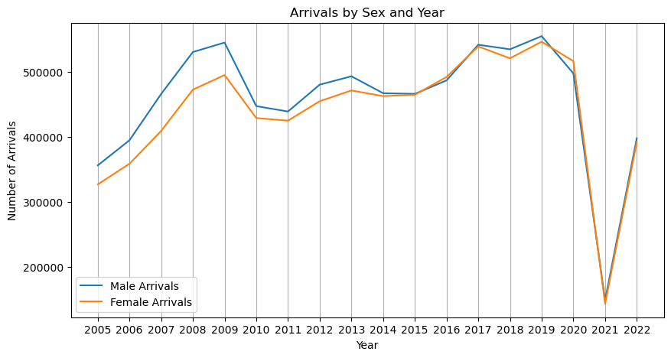
Gender

Slide 13
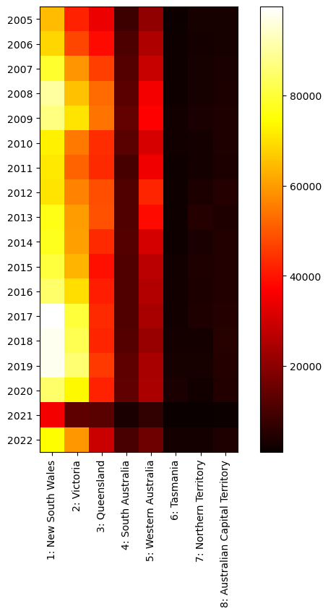

Gender
Male
Female

Slide 14
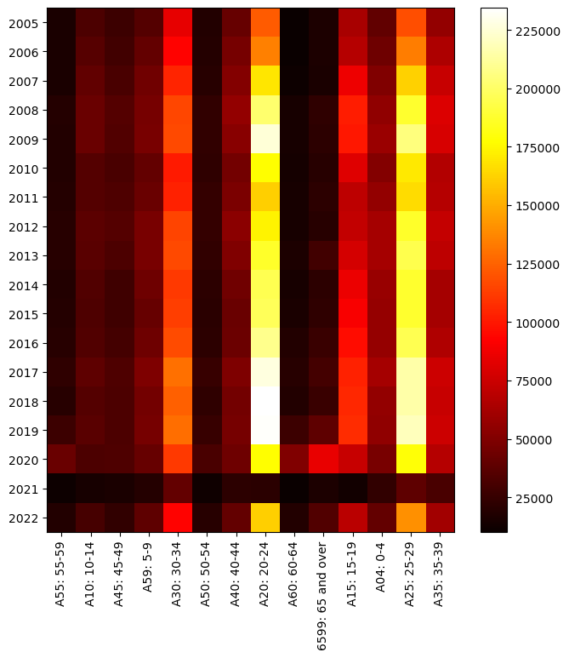
Age

Slide 15
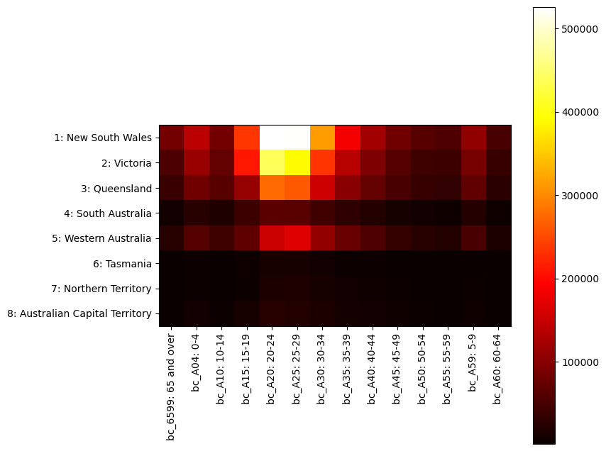
Age (Before COVID)

Slide 16
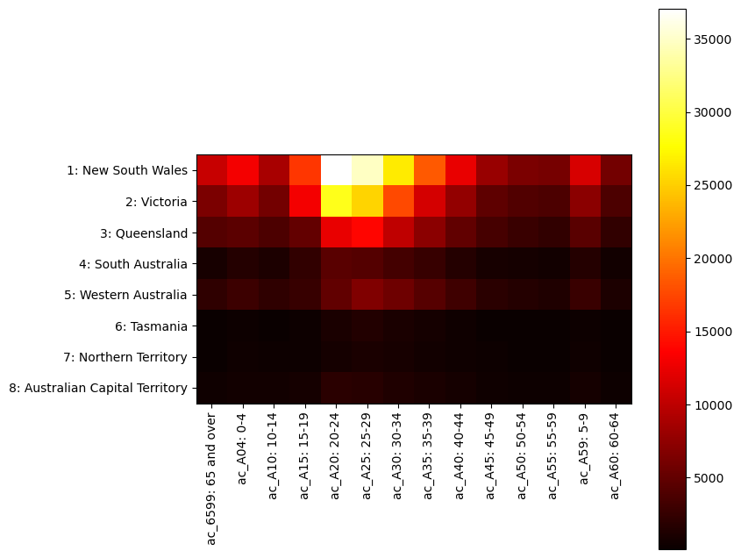
Age (After COVID)

Slide 17
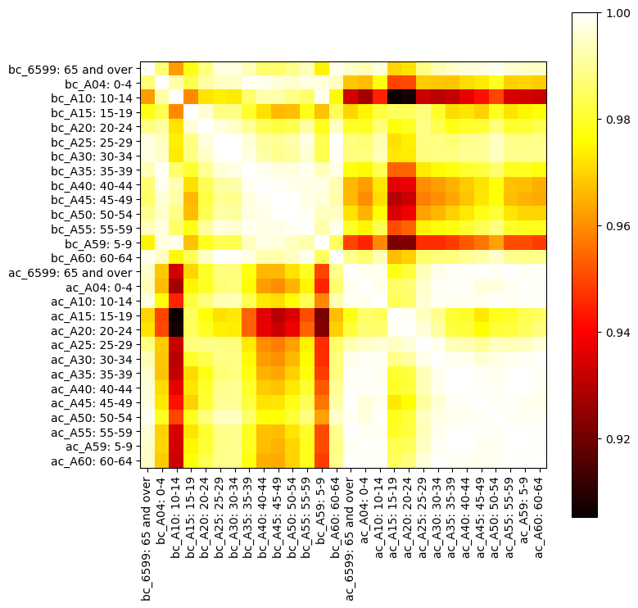
Age

Slide 18
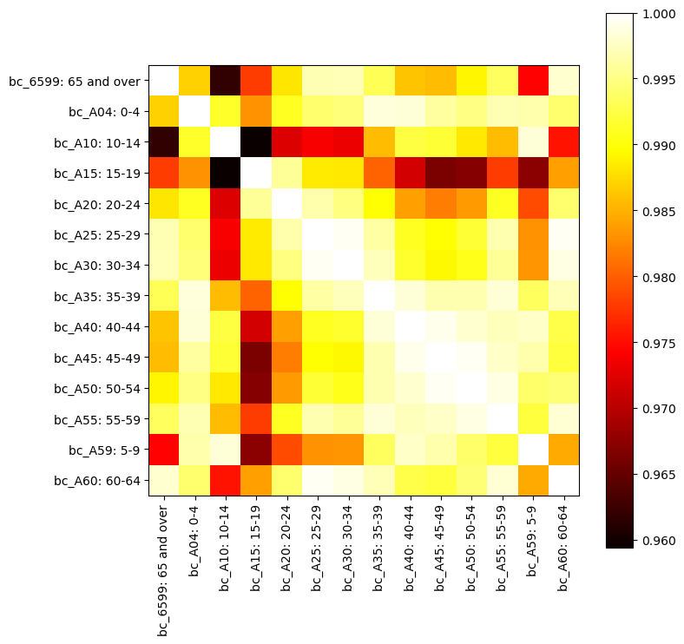
Age (Before COVID)

Slide 19
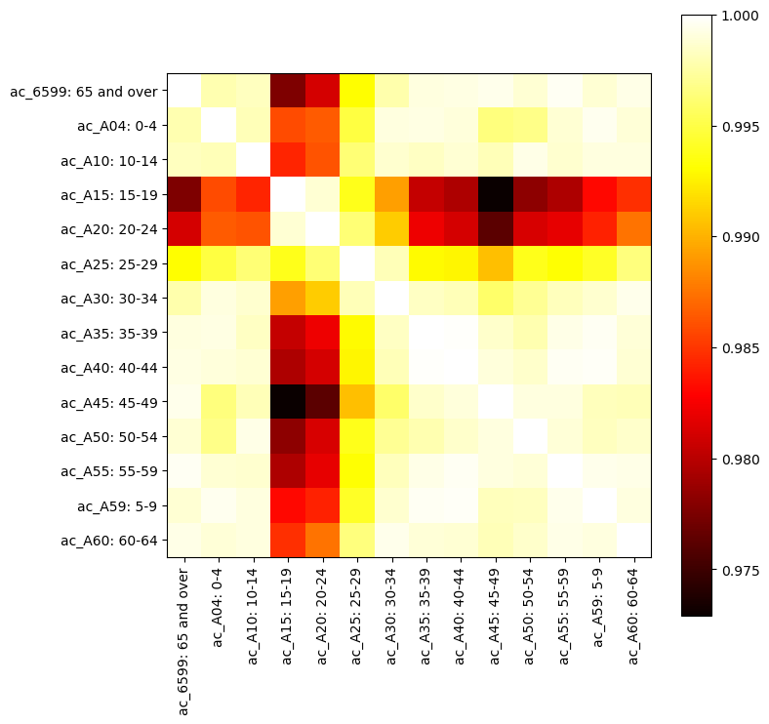
Age (after COVID)

Slide 20
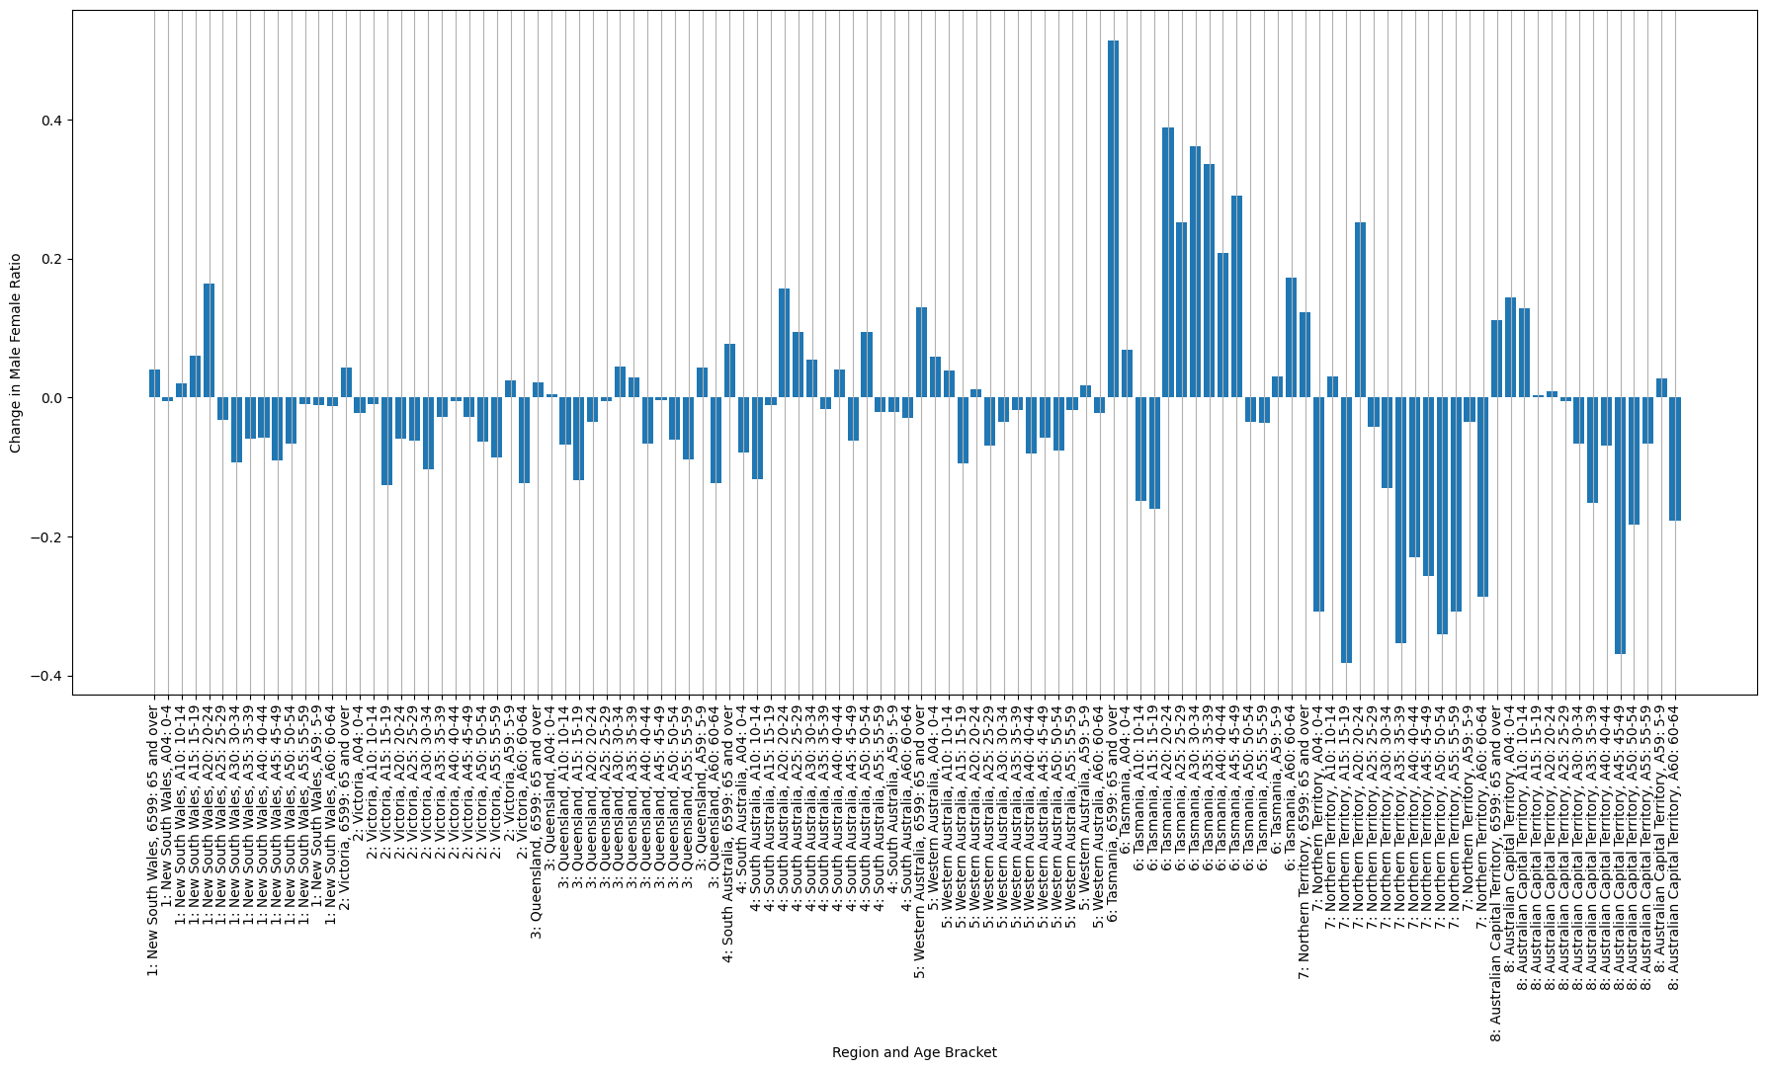
Age

Slide 21
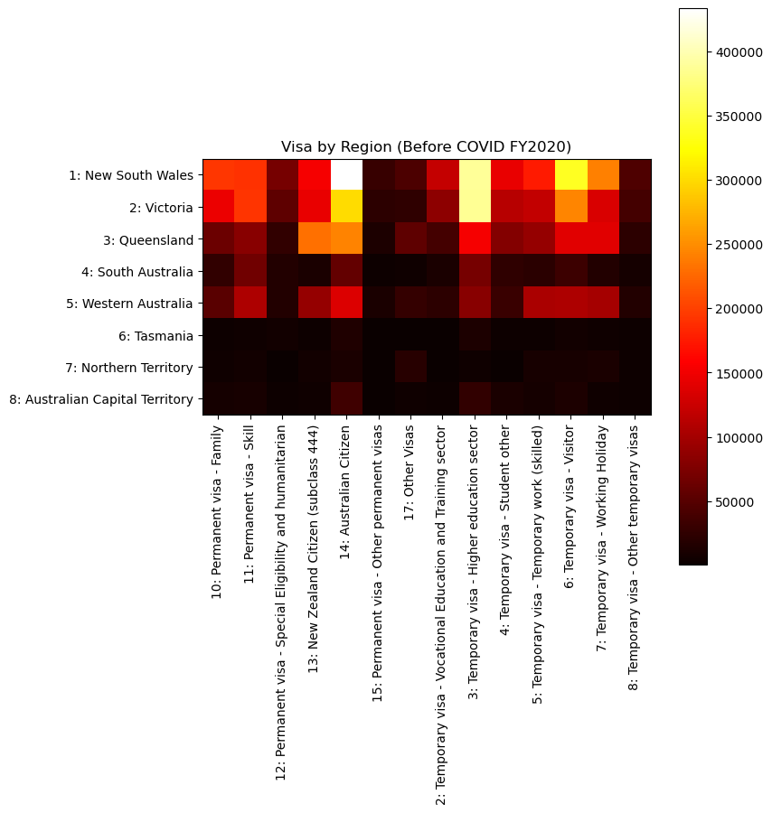
Visa by region (before covid)

Slide 22
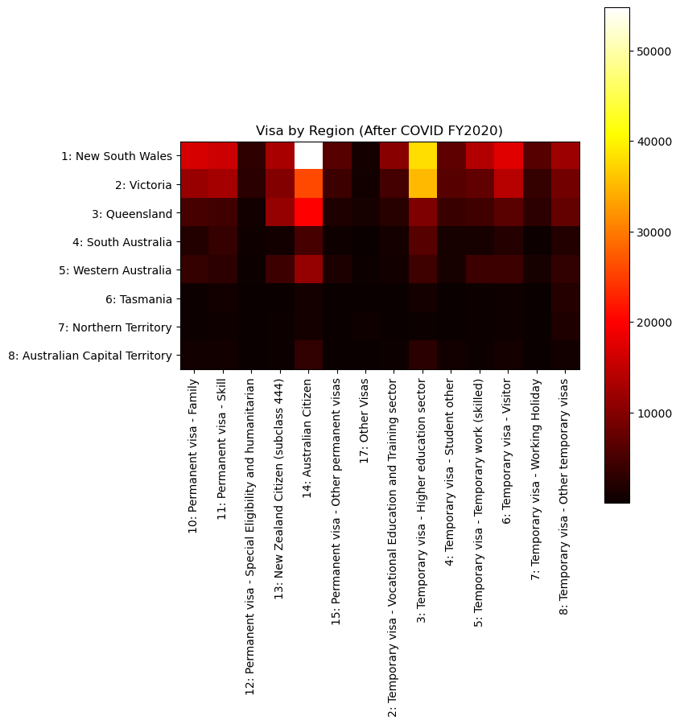
Visa by region (after covid)

Slide 23
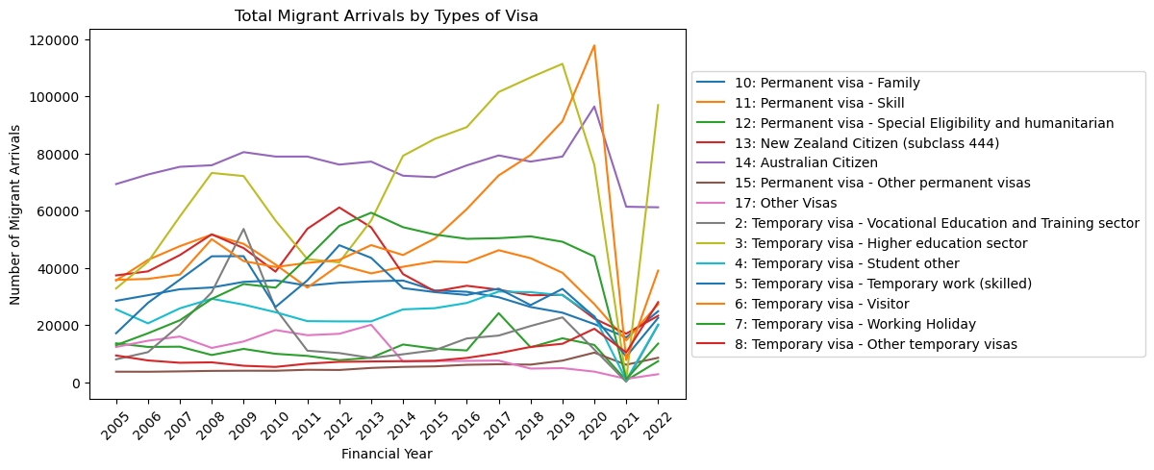
types of visa

Slide 24
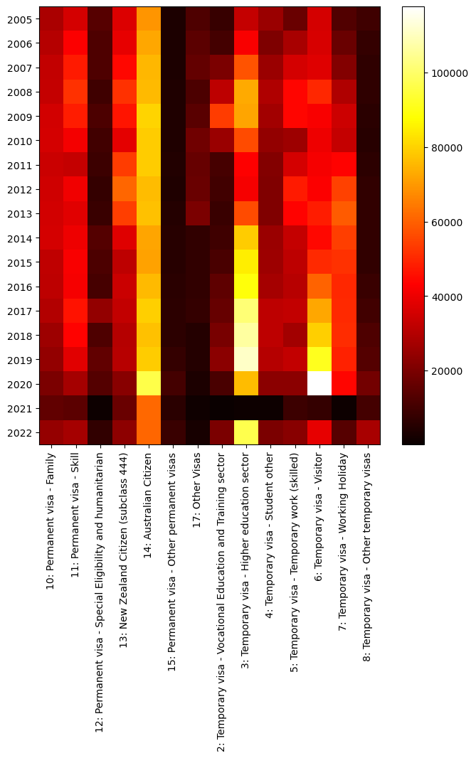
types of visa

Slide 25
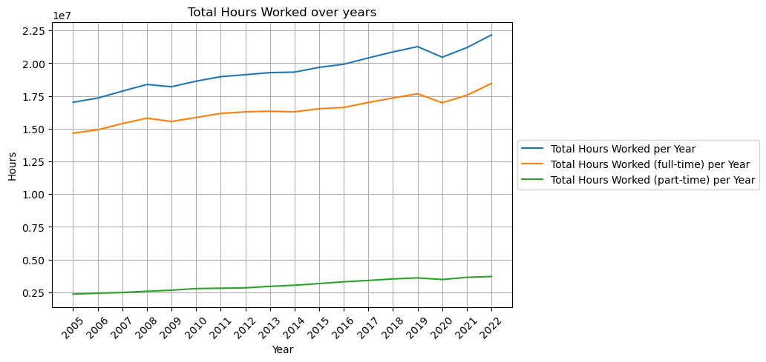
Work hours

Slide 26
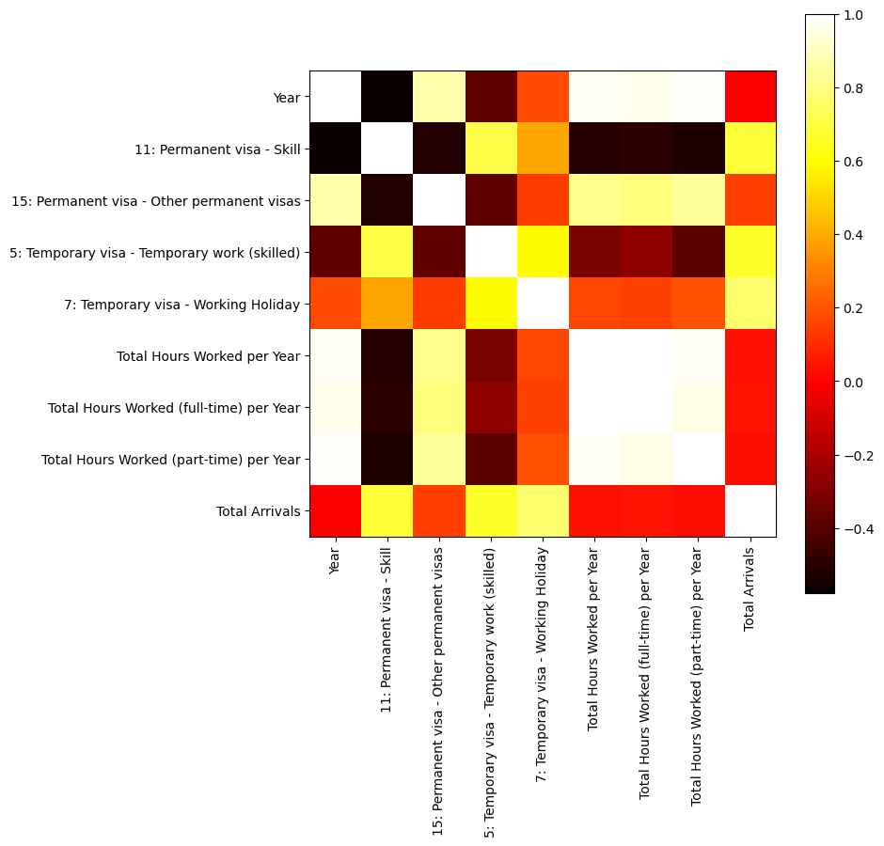
Correlation between migrant arrivals to Australia & worked hours

Slide 27
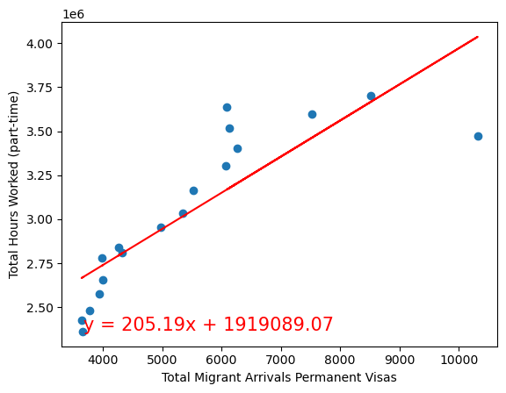

Total Hours Worked (part-time) vs. Total Migrant Arrivals Permanent Visas

Slide 28
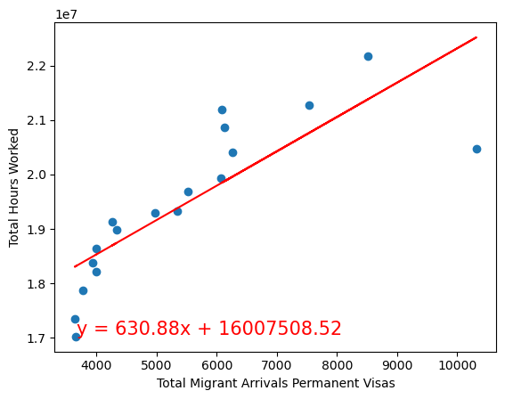

Total Hours Worked vs. Total Migrant Arrivals Permanent Visas

Slide 29
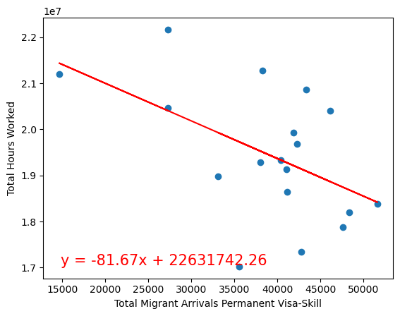

Total Hours Worked vs. Total Migrant Arrivals Permanent Visa - Skill

Slide 30
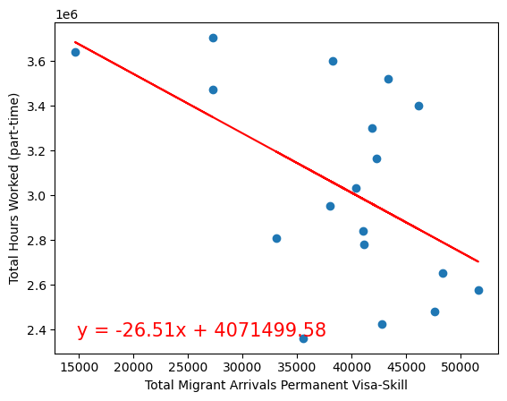

Total Hours Worked (part-time) vs. Total Migrant Arrivals Permanent Visa - Skill

Slide 31


Thank you
Bec, Anuja & Luz

